Slide 1
Lab 5
ITEC618 Labs
Programming Concepts
Dr. Farshid Keivanian

Slide 2
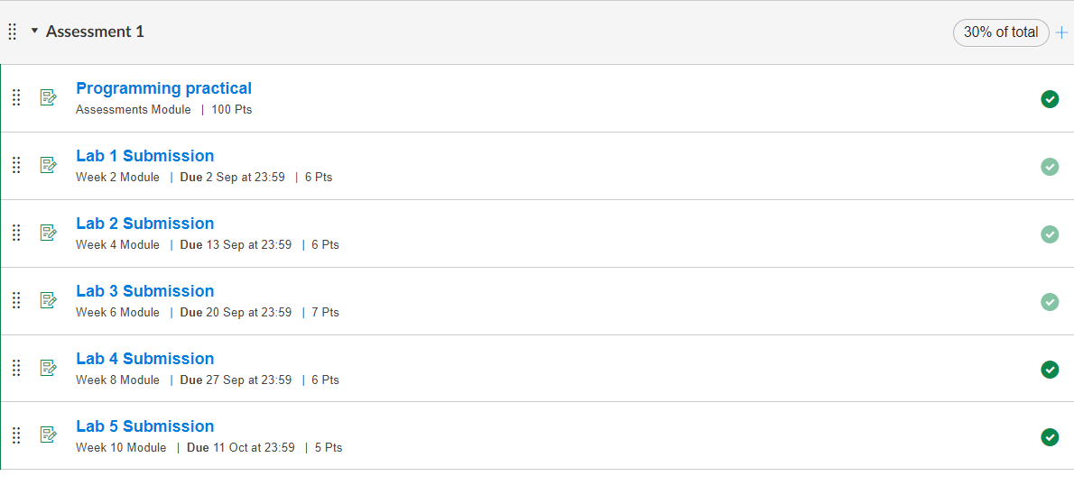

Slide 3
Task completion (3%)
Task completion (2%)
10.1 (2%) (Smart Access Account) Design a real-world class named 'Account' that contains at least the following:
• A private int data field named id for the account (default 0).
• A private double data field named balance for the account (default 0).
• A private double data field named annualInterestRate that stores the current interest rate (default 0). Assume that all accounts have the same interest rate.
• A private Date data field named dateCreated that stores the date when the account was
created.
• A no-arg constructor that creates a default account.
• A constructor that creates an account with the specified id and initial balance.
• The accessor and mutator methods for id, balance, and annualInterestRate, e.g., getBalance(),

Slide 4
Task completion (3%)
• setBalance(double b) etc.
• The accessor method for dateCreated, e.g., getDateCreated().
• A method named getMonthlyInterestRate() that returns the monthly interest rate.
• A method named getMonthlyInterest() that returns the monthly interest.
• A method named withdraw(double amount) that withdraws a specified amount from the
account.
• A method named deposit(double amount) that deposits a specified amount to the account.
• A toString() method that records a string representation of the status of the account. E.g., “The account id 123, created on April 1st, has a current balance of $20,000 and a monthly interest of $100”.

Slide 5
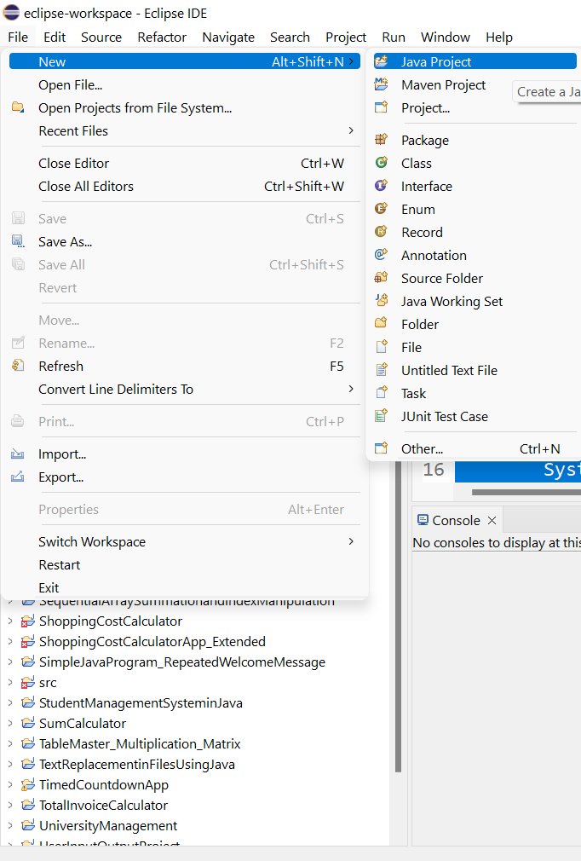
Step 1: Open Eclipse and Create a New Java Project
Open Eclipse.
Go to File > New > Java Project.
Name your project AccountProject and click Finish.

Slide 6
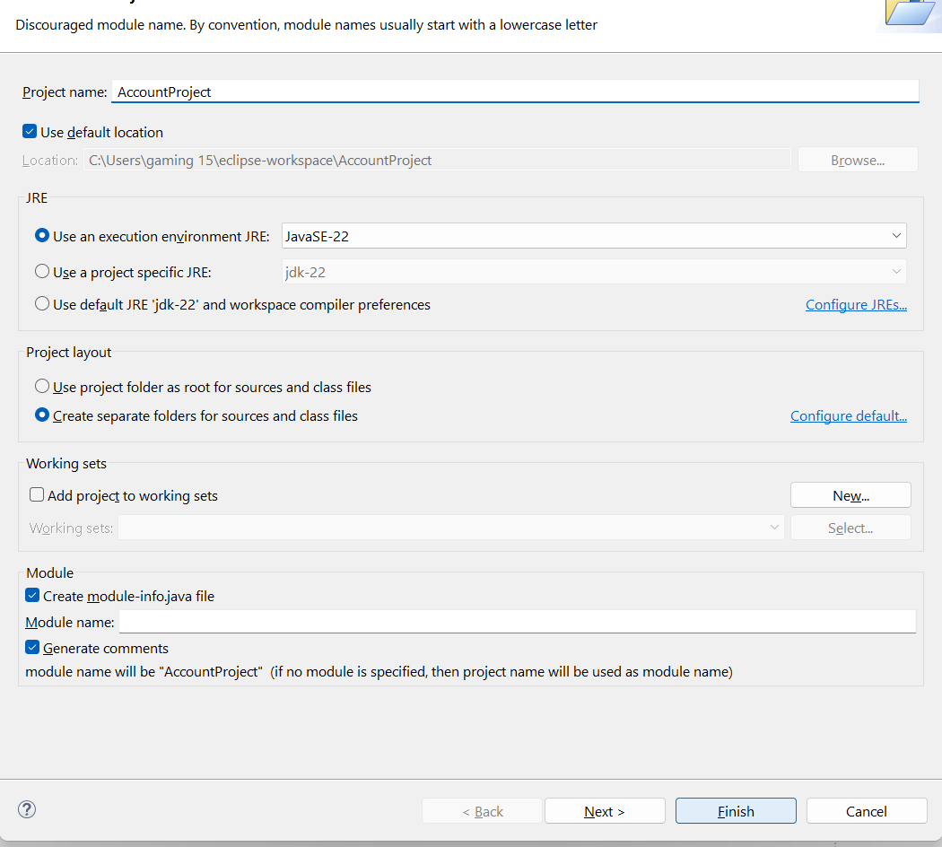
Step 1: Open Eclipse and Create a New Java Project
Open Eclipse.
Go to File > New > Java Project.
Name your project AccountProject and click Finish.

Slide 7
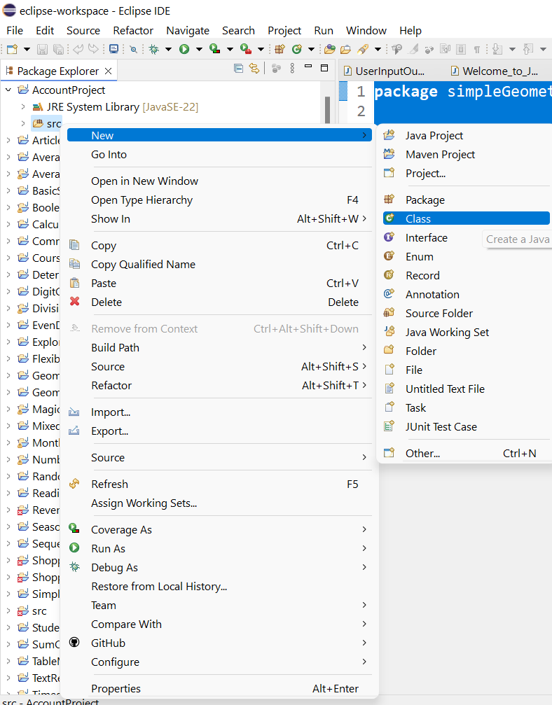
Step 2: Create a New Java Class
Right-click on the src folder inside your project.
Select New > Class.
Name the class Account and check the option to add the public static void main(String[] args) method (optional for now, we will add it later).

Slide 8
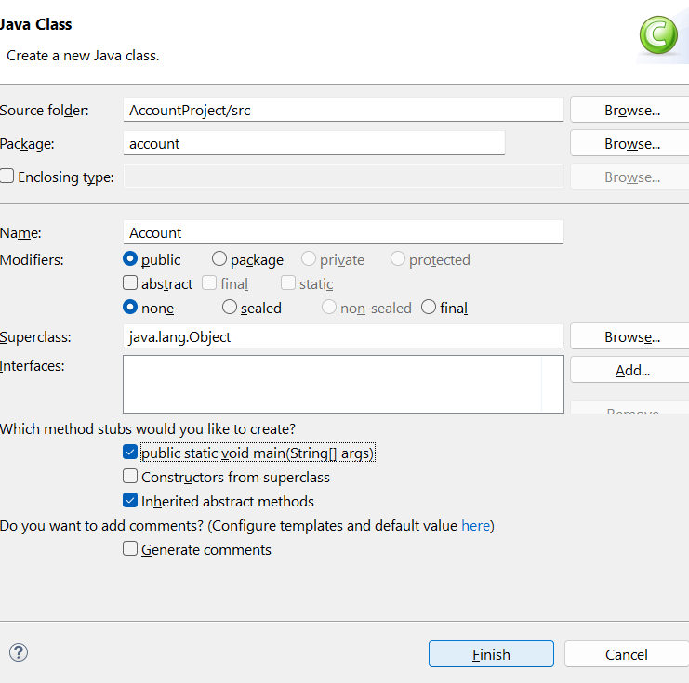
Step 2: Create a New Java Class
Right-click on the src folder inside your project.
Select New > Class.
Name the class Account and check the option to add the public static void main(String[] args) method (optional for now, we will add it later).

Slide 9
Step 3: Write the Account Class
Here’s the complete code for the Account class.
C:\Users\...\eclipse-workspace\AccountProject\src\account

Slide 10
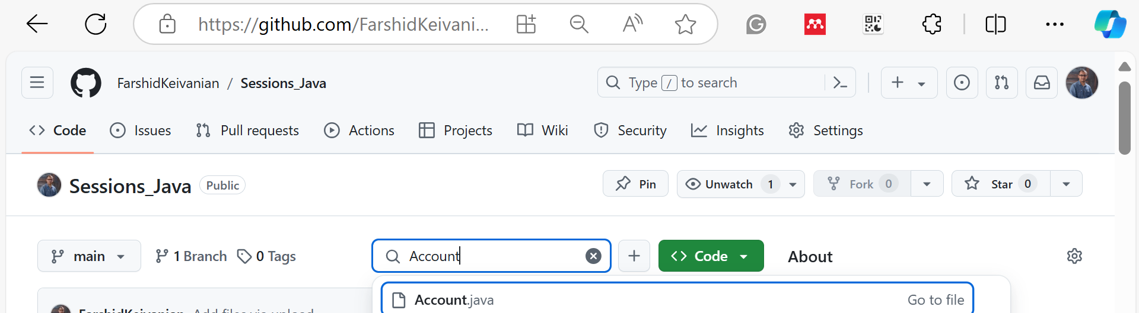
Step 3: Write the Account Class
Here’s the complete code for the Account class.
C:\Users\...\eclipse-workspace\AccountProject\src\account

Slide 11
An account is created with ID 1 and an initial balance of 1000.
The annual interest rate is set to 4.5%.
A withdrawal and deposit operation is demonstrated, and the account details are printed before and after these operations.

Slide 12
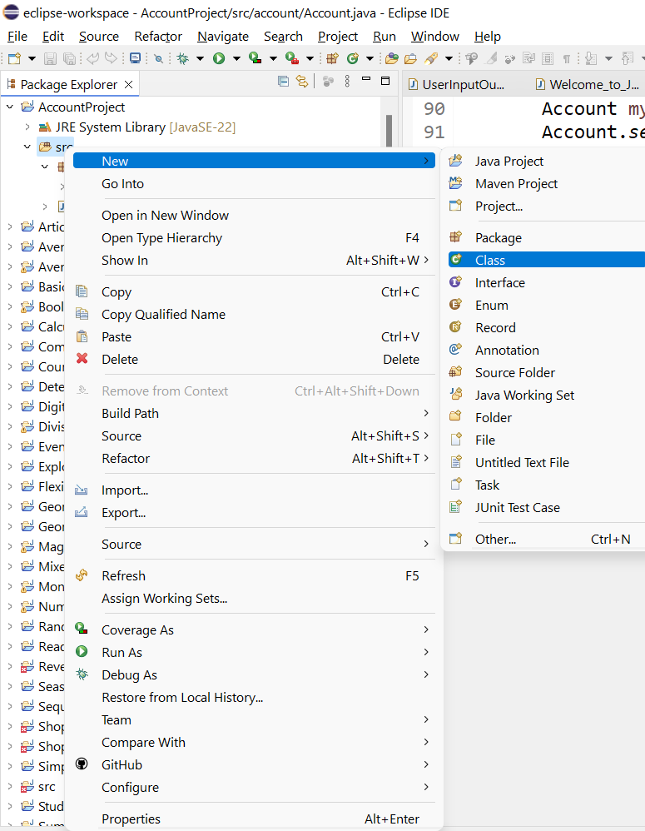
Step 4: Create a Test Class with the main Method
To run the program, we will create a simple test class that demonstrates how to use the Account class.
Right-click on the src folder.
Select New > Class.
Name this class TestAccount and ensure the public static void main(String[] args) checkbox is selected.

Slide 13
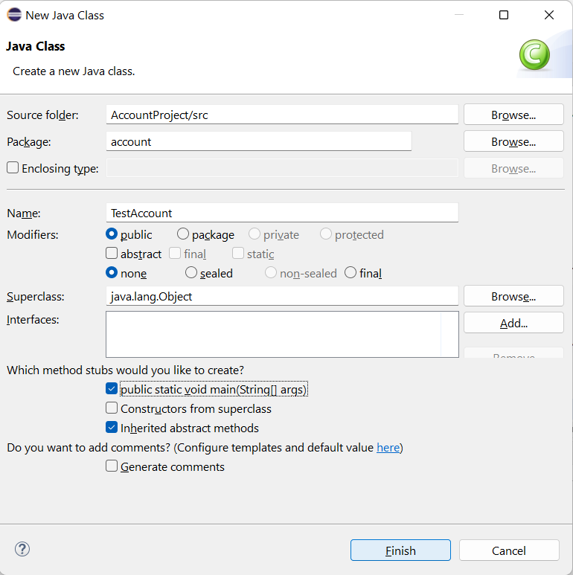
Step 4: Create a Test Class with the main Method
To run the program, we will create a simple test class that demonstrates how to use the Account class.
Right-click on the src folder.
Select New > Class.
Name this class TestAccount and ensure the public static void main(String[] args) checkbox is selected.

Slide 14
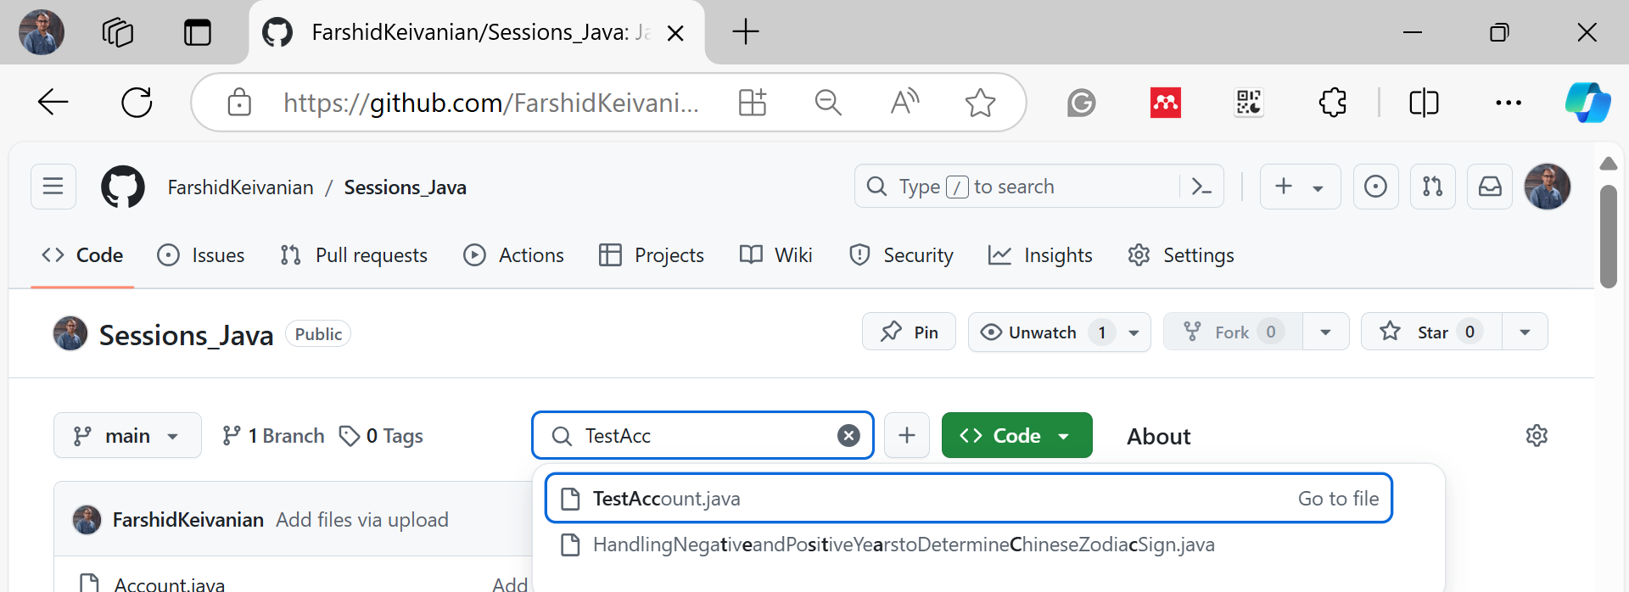
Step 4: Create a Test Class with the main Method
To run the program, we will create a simple test class that demonstrates how to use the Account class.
Right-click on the src folder.
Select New > Class.
Name this class TestAccount and ensure the public static void main(String[] args) checkbox is selected.

Slide 15
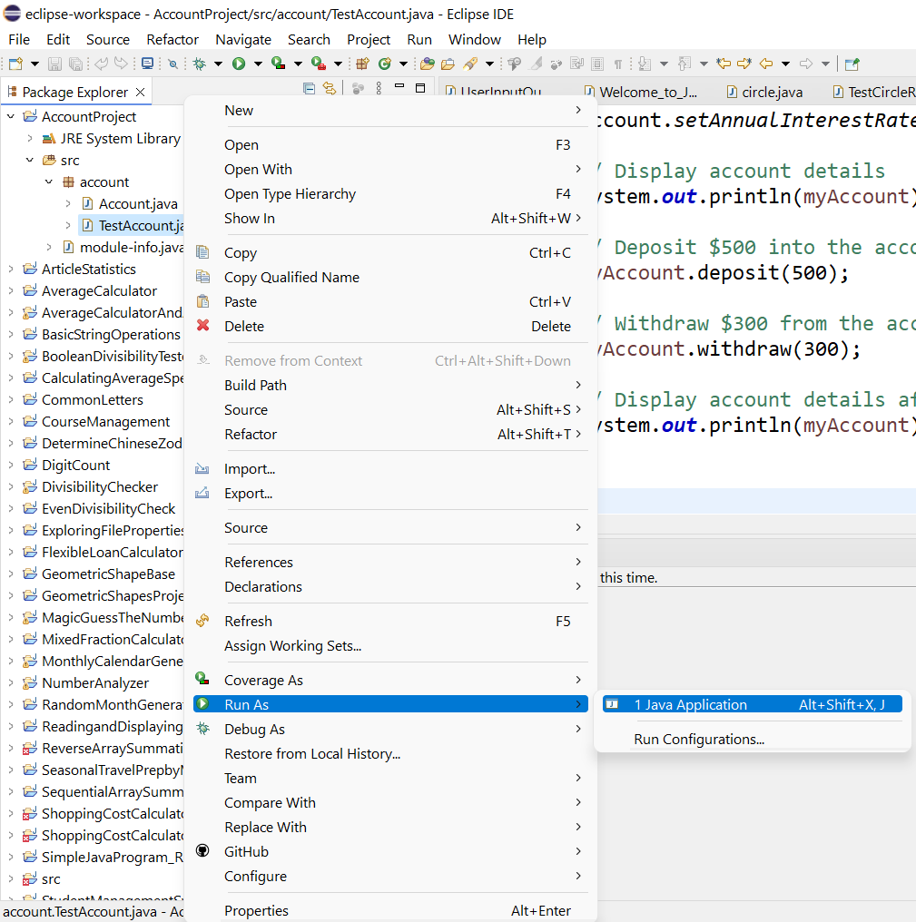
Step 5: Running the Program
Right-click on the TestAccount.java file.
Select Run As > Java Application.
The output in the console should look something like this:

Slide 16
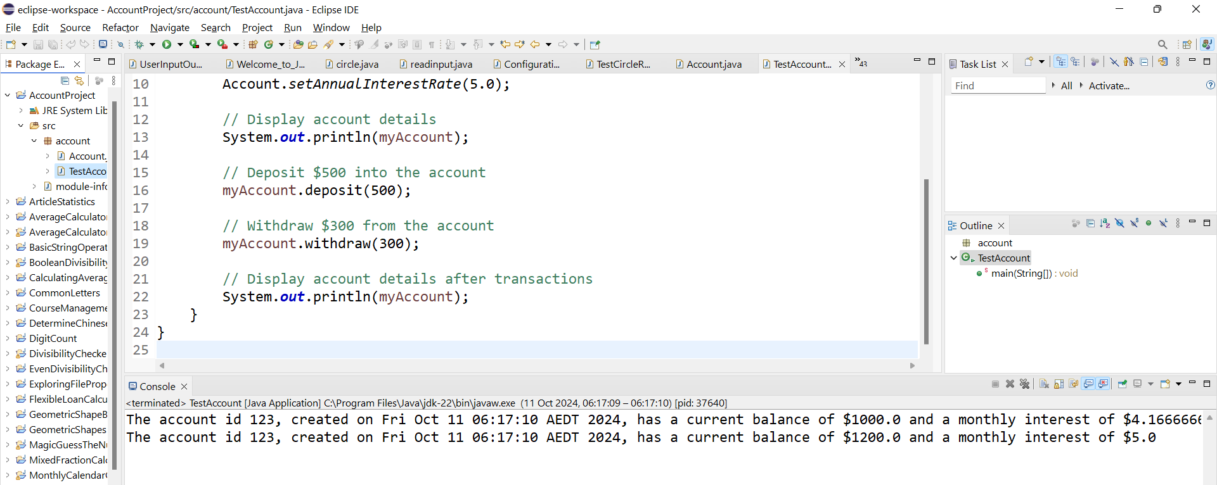
The main method:
Creates an Account object with an initial balance of $1000 and ID 123.
Sets the annual interest rate to 5%.
Deposits $500 and withdraws $300.
Prints the account details before and after the transactions.

Slide 17
Minor Change Suggestion for Students
To demonstrate additional skills, you can modify the withdraw method to add a check that prevents withdrawing negative amounts and provides an error message.
public void withdraw(double amount) {
if (amount <= 0) {
System.out.println("Amount to withdraw must be greater than 0.");
} else if (amount <= balance) {
balance -= amount;
} else {
System.out.println("Insufficient balance.");
}
}

Slide 18
This simple change demonstrates attention to error handling, a valuable skill in programming. Students can show they are thinking about corner cases and validating user inputs.
public void withdraw(double amount) {
if (amount <= 0) {
System.out.println("Amount to withdraw must be greater than 0.");
} else if (amount <= balance) {
balance -= amount;
} else {
System.out.println("Insufficient balance.");
}
}

Slide 19
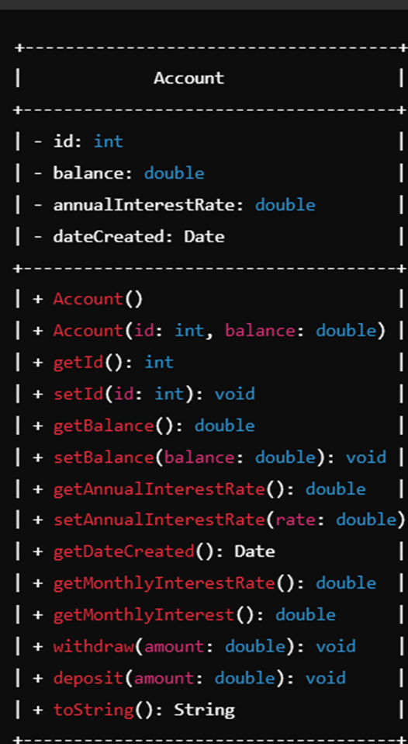
A simple UML diagram for the Account class based on the requirements

Slide 20
Suggested Minor Change
As a minor change, you can add a minimum balance restriction to the withdraw method. This demonstrates your ability to add business logic constraints to their program.

Slide 21
// Method to withdraw money from the account with a minimum balance restriction
public void withdraw(double amount) {
double minimumBalance = 500; // New minimum balance restriction
if (amount <= 0) {
System.out.println("Amount must be positive.");
} else if (balance - amount >= minimumBalance) {
balance -= amount;
} else {
System.out.println("Insufficient funds or balance will fall below minimum balance of $" + minimumBalance);
}
}

